Slide 1
Microsoft Power Platform
Notes:
Hi, Welcome to Microsoft Power Platform

Slide 2
Day 1: Power Packed Day with Power Canvas Apps - Part 2

Slide 3

Agenda
Introduction to Power Apps
Benefits of Power Apps
What can I build with Power Apps?
Types of Power Apps
Canvas Apps
Data Sources and Connectors
Demo

Slide 4
Benefits of low-code app development
Focus on innovating. We take care of the rest.
Increased development agility
Automate and enhance repetitive and time-consuming processes and reduce errors across your organization.
Speed & savings
Reduce time & cost building web and mobile applications, enabling you to get through your development backlog.
Efficiency
Effortless Dynamics 365, Office 365, and Azure integration. Remove your data siloes through low-code with Common Data Service and AI Builder.
Gartner estimates that 65% of all app dev will be low code by 2024

Slide 5
Power Apps provides quantitative benefits for your organization compared to traditional development
70%
Less application development cost & effort
362%
Return on investment over 3-year term

Slide 6
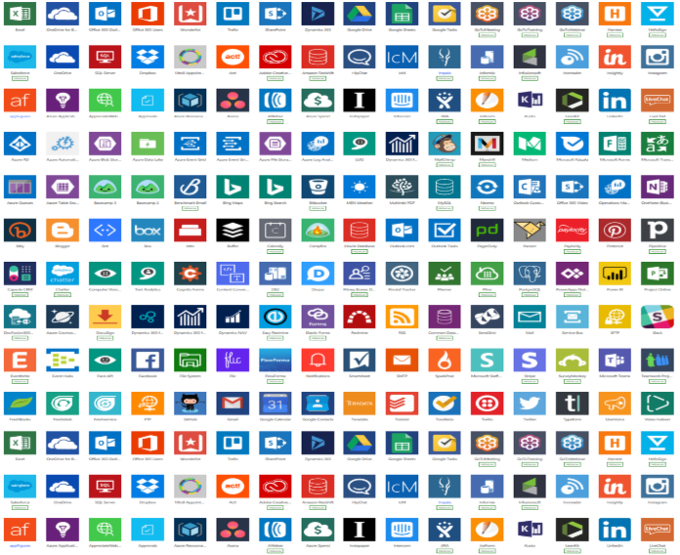
Low code in digital transformation
Some processes are best solved by off-the-shelf SaaS solutions.
But there isn’t always “an app for that.”
Some processes are best be solved by custom app development.
But there is only so much custom app development an organization can invest in.
Everything else is a missed opportunity to optimize and innovate. Low-code development solves this for you.

Slide 7
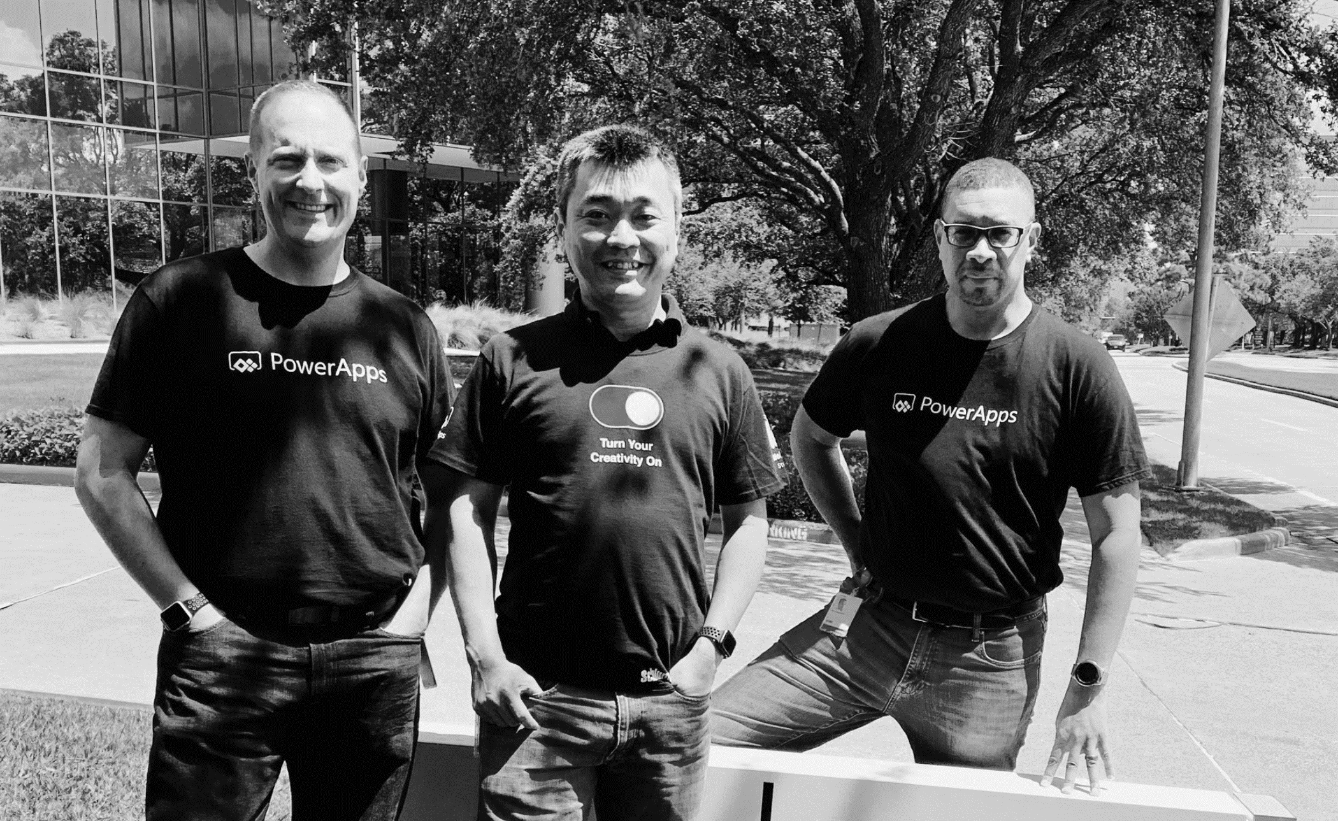
Pro dev
Citizen dev
IT admin
Empower every developer to do more.

Slide 8
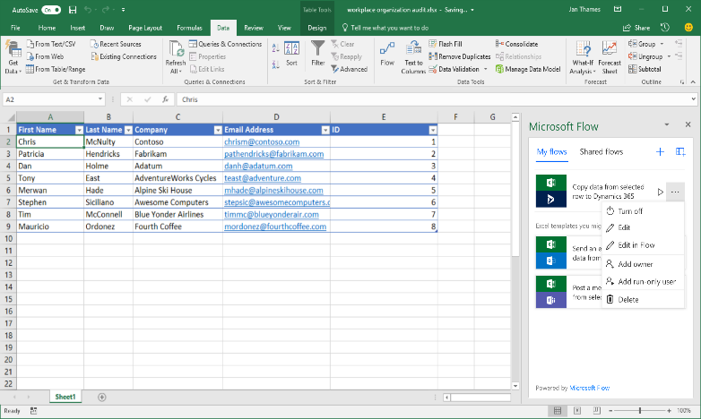
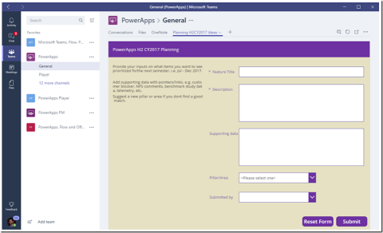
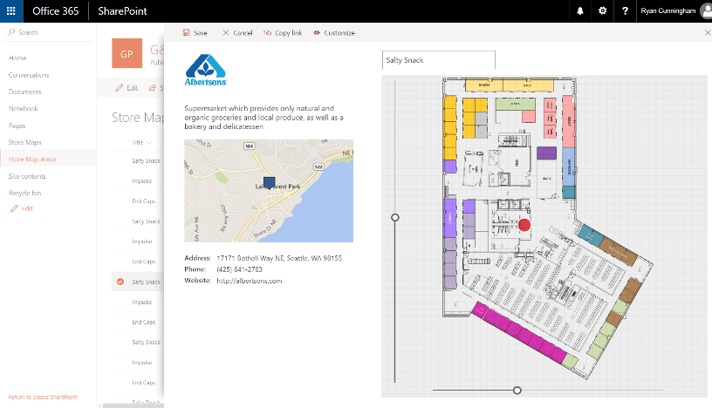
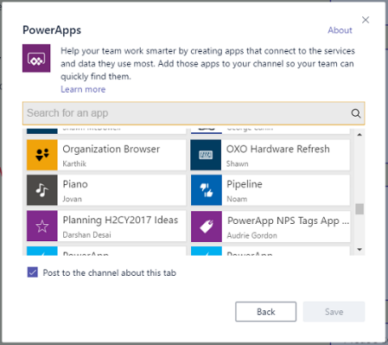
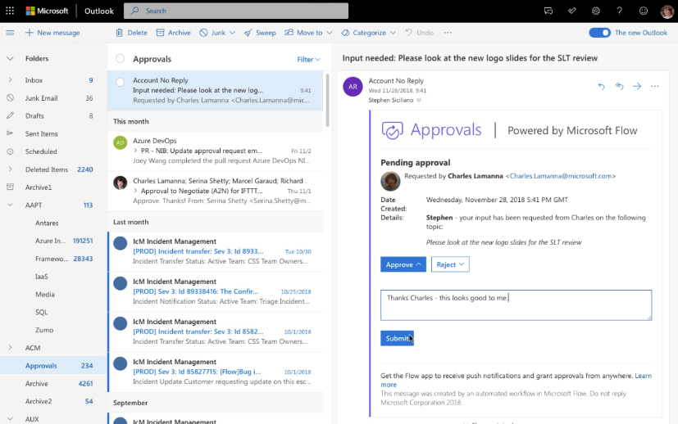
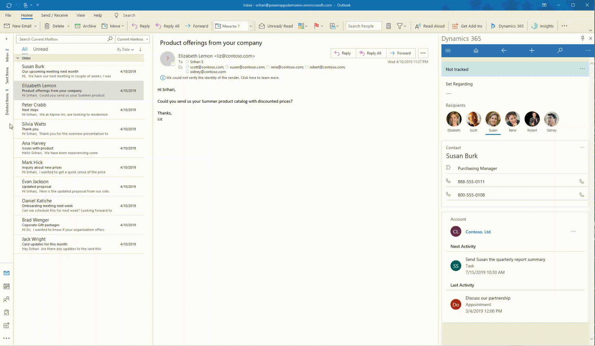
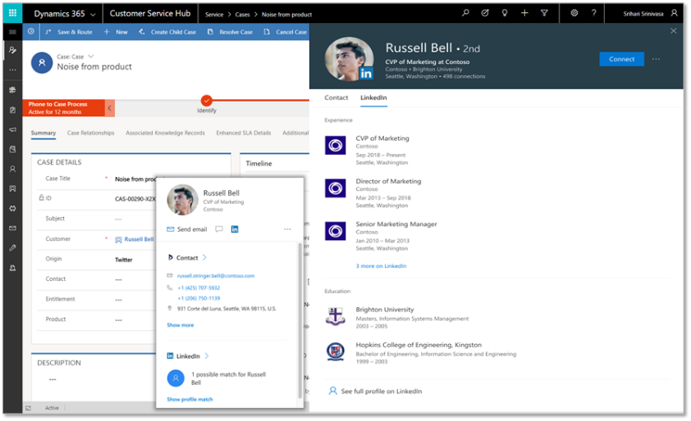
Deeply integrated with Microsoft 365
Customize the experience and automate SharePoint Lists with PowerApps and Flow
Build a PowerApp app from an Excel sheet or automate on an Excel sheet with Flow
Customize a tab with PowerApps, or automate a bot or process with Flow
Enhanced communication with Actionable Messages and Adaptive cards in Flow
Bring data from CDS and PowerApps UX to Outlook with the Mail App (WIn32, OWA and mobile)
Office 365 People Card in PowerApps + Dynamics (incl. LinkedIn info)

Slide 9
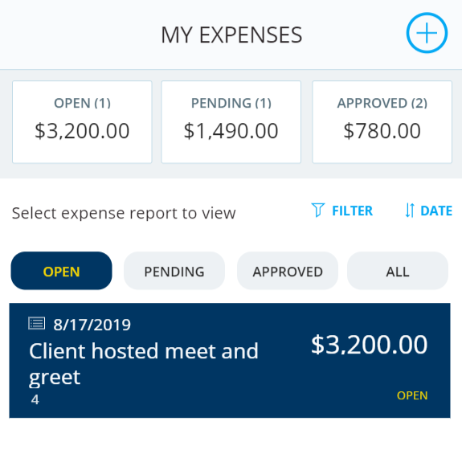
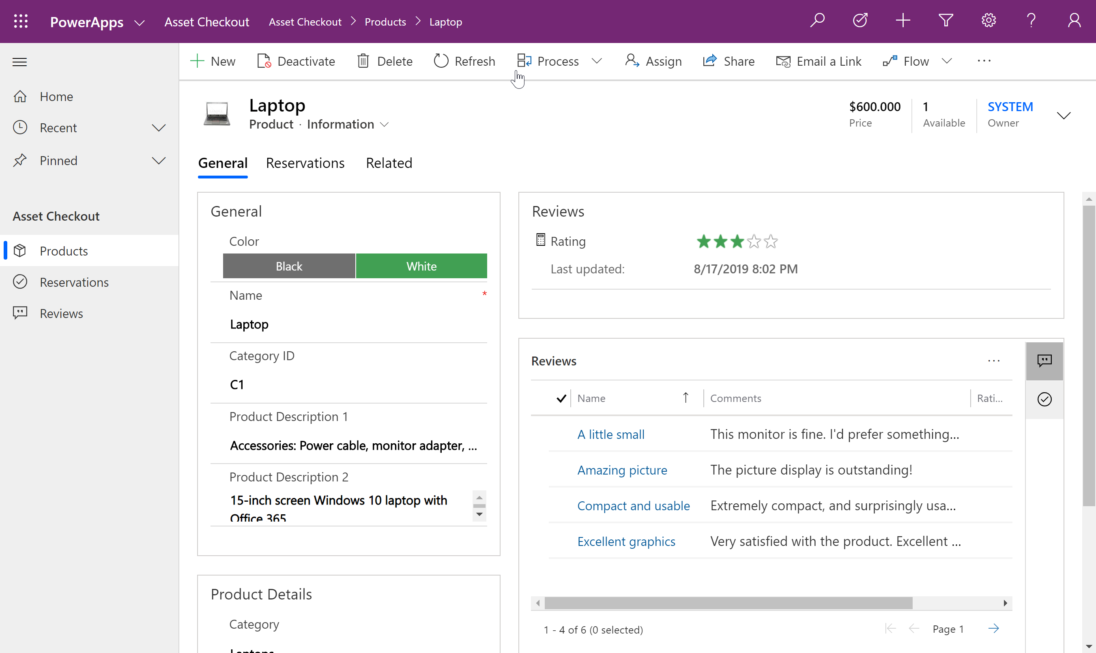
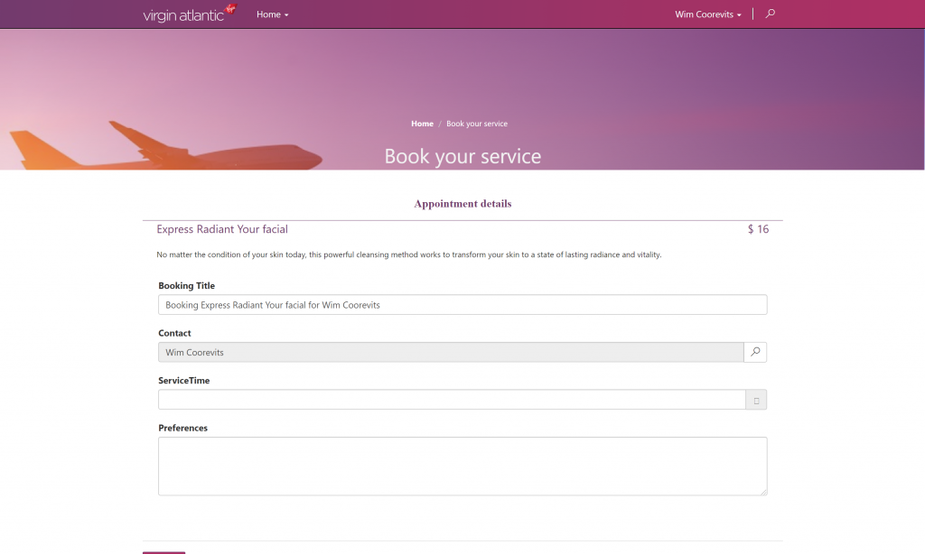
Types of Power Apps
Canvas Apps
Model Driven Apps
Portals

Slide 10

Canvas Apps

Slide 11

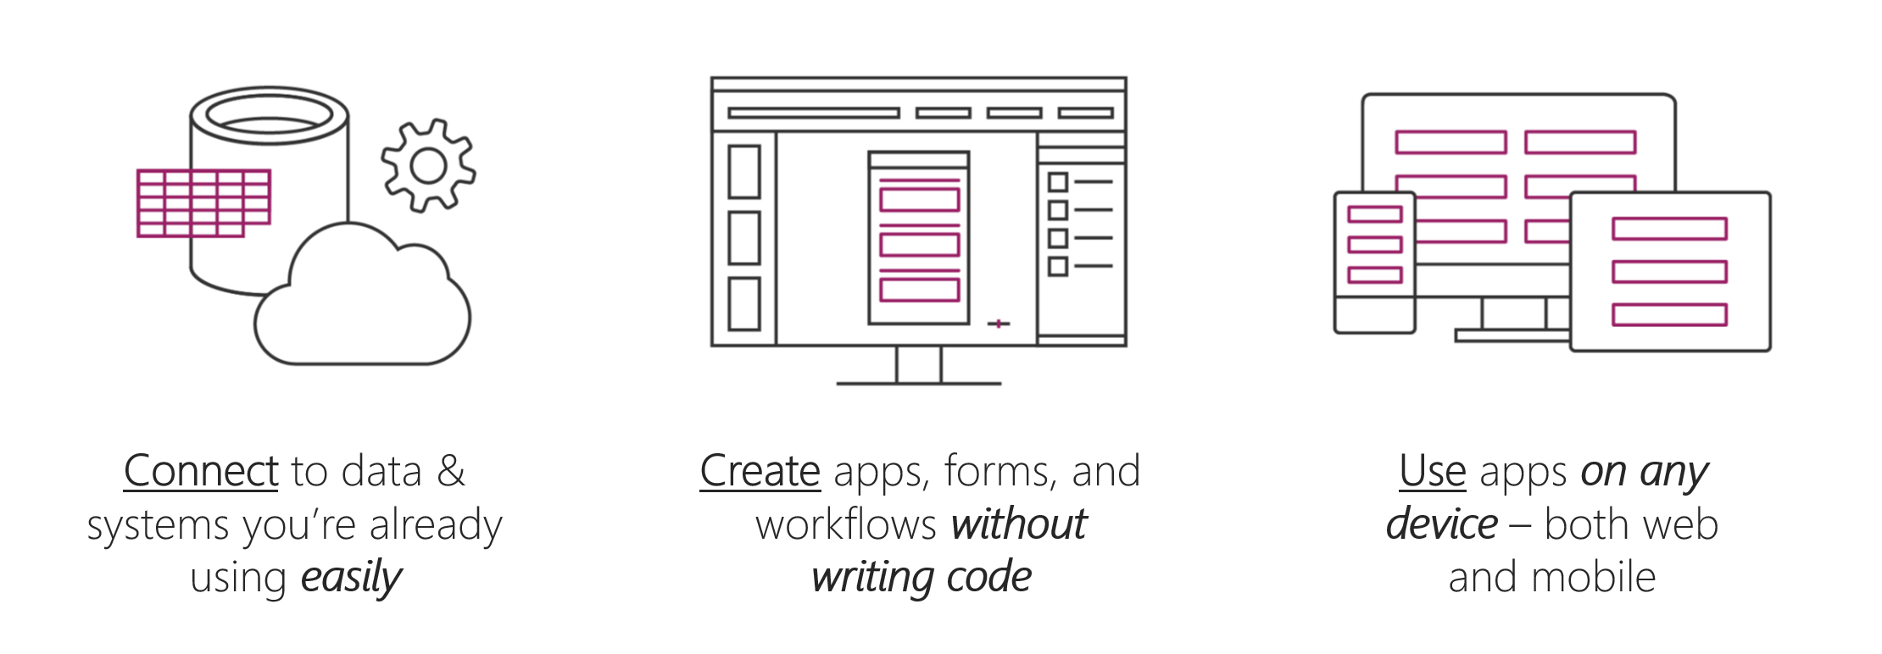
Introduction to Power Apps
Rapid low code development environment for building custom apps
Enables the creation of web and mobile applications that run on all devices.
Business users or pro developers can build custom apps, when out of the box solutions do not meet exact business needs.

Slide 12
Power Apps building blocks
Power Apps Home Page
Start building Apps from data, a sample app, or a blank screen.
Power Apps Studio
Develop your apps further by connecting to data, adding and arranging user interface (UI) elements (known as controls), and building formulas.
Power Apps Mobile
Run your apps on Microsoft Windows, Apple iOS, and Google Android devices.
Power Apps Admin Center
Manage Power Apps environments and other components.

Slide 13
Create your first app in Power Apps
Connect to a data source - OneDrive for Business
Notes:
https://docs.microsoft.com/en-us/learn/modules/get-started-with-powerapps/5-powerapps-create-first

Slide 14
Ways to build Power Apps
Create an app from a template
Create an app from a data source
Special data source (SharePoint)
Build from a blank canvas

Slide 15
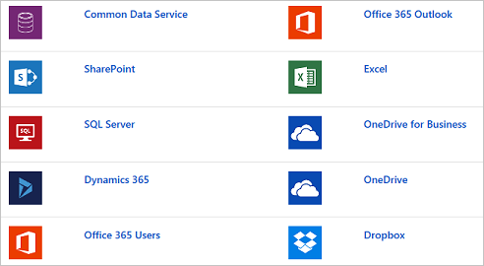

Data sources, connections, and gateways
Image source: https://docs.microsoft.com/en-us/learn/modules/get-started-with-powerapps/3-powerapps-related-technologies

Slide 16

Microsoft Dataverse
Store and manage data within a set of tables.
Benefits of using Microsoft Dataverse:
Simple to manage
Secure data
Access data from Dynamics 365
Rich metadata
Logic and validation
Productivity tools

Slide 17
Designing a Power Apps app
Design process:
Business requirements
Data Model
User Experience (UX)
User Interface (UI)

Slide 18
Summary
Use Power Apps Studio (make.powerapps.com) to create and share your Apps.
Use Power Apps Admin Center to administer your apps
Connect to related technologies - Microsoft Dataverse, Power Automate, Microsoft SharePoint, and other data sources.
Create an app by using several different methods (from template, data source, or blank canvas)

Slide 19
Use the UI and controls in a canvas app in Power Apps
Notes:
https://docs.microsoft.com/en-us/learn/paths/ui-controls-canvas-app-powerapps/

Slide 20
Navigation
Why navigation?
Navigate function
Navigate(Screen, ScreenTransition [, UpdateContextRecord ])
Back function
Hidden screens
Visual transition
(optional) updates context variables of the new screen
Name of screen to display

Slide 21
Create navigation and back functions
Manage navigation
Notes:
https://docs.microsoft.com/en-us/learn/modules/navigation-canvas-app/3a-exercise-create-navigation-functions

Slide 22
Build the UI in a canvas app in Power Apps
Notes:
https://docs.microsoft.com/en-us/learn/paths/ui-controls-canvas-app-powerapps/

Slide 23
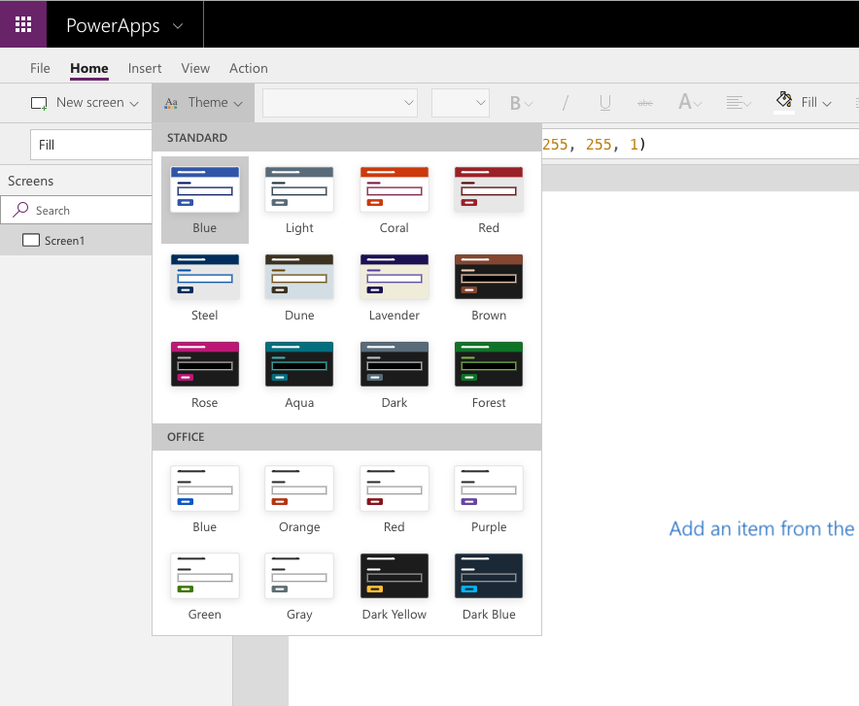
Themes
Image source: https://docs.microsoft.com/en-us/learn/modules/how-to-build-ui-canvas-app/1-use-themes

Slide 24
Branding a control
Typical properties
BorderColor
BorderStyle
Color
Fill
Disabled properties
DisabledColor
DisabledFill
Hover properties
HoverColor
HoverFill

Slide 25
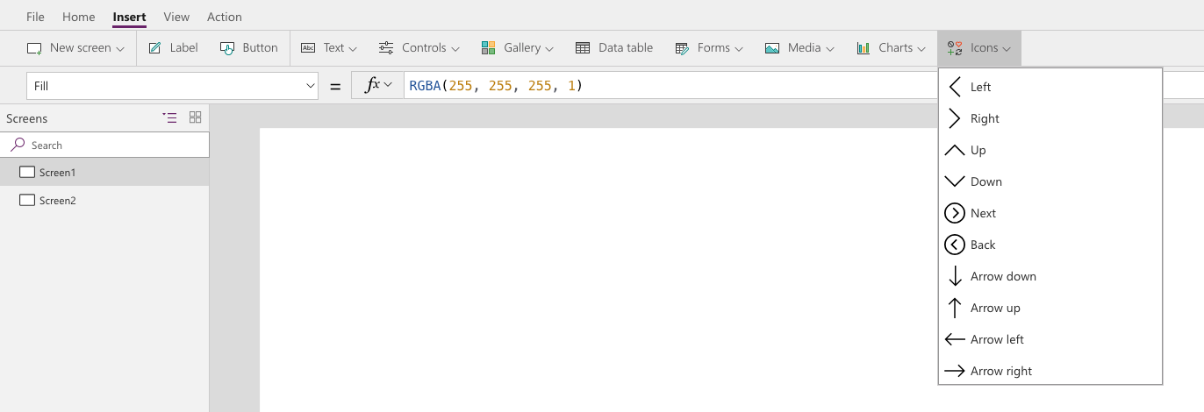
Icons
Image source: https://docs.microsoft.com/en-us/learn/modules/how-to-build-ui-canvas-app/3-icons

Slide 26
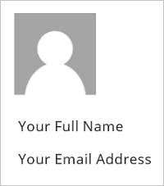
Personalization
User() function
User().Email
User().FullName
User().Image
Image source: https://docs.microsoft.com/en-us/learn/modules/how-to-build-ui-canvas-app/5-personalization

Slide 27
Create UI for a new canvas app
Notes:
https://docs.microsoft.com/en-us/learn/modules/how-to-build-ui-canvas-app/6a-exercise-create-new-ui

Slide 28
Controls in a canvas app in Power Apps

Slide 29
Introduction to controls
Galleries
Data table
Forms
Media
Charts
Icons

Slide 30
Create a canvas app with unique controls
Notes:
https://docs.microsoft.com/en-us/learn/modules/how-to-build-ui-canvas-app/6a-exercise-create-new-ui

Slide 31
Imperative development techniques for canvas apps in Power Apps

Slide 32
Imperative versus declarative development
Imperative
Declarative
Function Create Sandwich
{ Go to kitchen;
Get ingredients;
Remove tomato;
Assemble sandwich;}
Function Send Sandwich
{ Destination Mouth;}
GetSandwich(Kitchen, Mouth)
GetSandwich(Kitchen, Mouth, {Tomato: false})

Slide 33
Variables in Power Apps
Global variables
Set(varUserDisplayName, User().FullName)
Context variables
UpdateContext({varShowPopUp: true})
Collections
Collect(collectProjects, Projects)
Dynamic Collections
Collect(collectColors, {Name: "Shane", FavoriteColor: "Orange"}, {Name: "Mary", FavoriteColor: "Blue"})

Slide 34
Using the variables and collections
Notes:
https://docs.microsoft.com/en-us/learn/modules/use-imperative-dev-techniques-powerapps-canvas-app/6a-exercise-variables-collection

Slide 35
Performance of an app

Slide 36
Most common performance bottleneck
Data sources
Too many refreshes
Too many lookups
Storing data in the wrong data source

Slide 37
Improve performance with data sources
Use collections to cache data
Delegation
Concurrent function to load multiple data sources

Slide 38
Using the Concurrent function to test performance

Slide 39
Thank you

